Slide 1
DATA SCIENCE Project Presentation
Presented By:
Muhammad Ali Turk

Slide 2
TABLE OF CONTENTS
01
02
03
04
05
06
07
Introduction
RFM
08
EDA
Gradient Boosting
09
Test Train Split
Undersampling,oversampling
10
Data Preprocessing
Model Comparison
11
Imbalanced data
Final Graph
Logistic Regression

Slide 3

INTRODUCTION
In this project, we will create a classification model to identify fraud in credit card transactions. We'll also investigate coping with very skewed datasets, which are common in this sort of assignment. Let's have a look at our dataset.

Slide 4
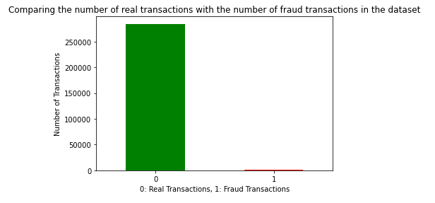
02
EDA
First, let's do a quick EDA on our dataset. We can notice the significant imbalance between our target variable's two classes.

Slide 5

03
Train-Test Split
But first, before we do anything else, let's split the data into training and testing. We'll divide the training and testing datasets so that the proportions of class 1 and class 0 are the same in both datasets.

Slide 6
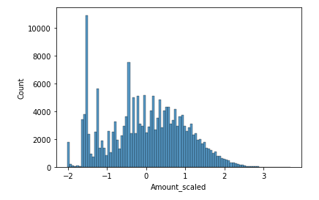
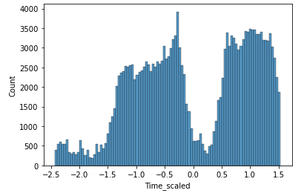
04
Data Preprocessing
We'll then scale Time and Amount. The PowerTransfomer will be used to automatically scale and normalize the two variables.

Slide 7
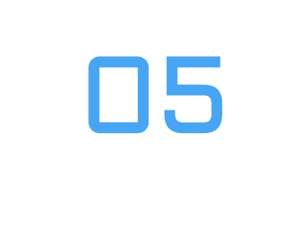
Imbalanced Data
Steps:
Logistic regression
Random Forest
Gradient Boosting
Imbalanced datasets are inconvenient to work with, although certain models perform better than others. With unbalanced data, tree-based and boosting algorithms often outperform.

Slide 8
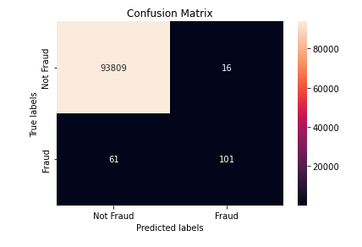
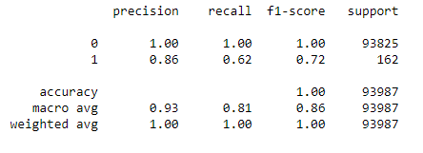
06
Logistic Regression
According to the confusion matrix and classification report, the logistics regression model has an accuracy of 0.86 and a recall of 0.62 for class 1. This indicates that while 86% of its fraud predictions were right, only 62% of the fraud transactions were caught.

Slide 9
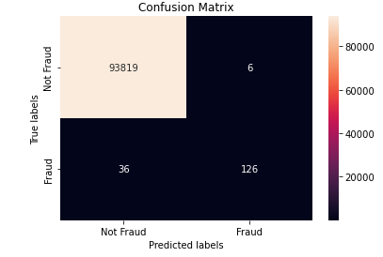
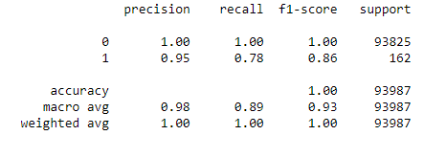
07
RFM
Next, let's try using a model that is intrinisically better at dealing with imbalanced datasets. We'll start with RandomForest.
We can observe that RandomForest outperformed logistical regression! The F-1 score is significantly higher

Slide 10
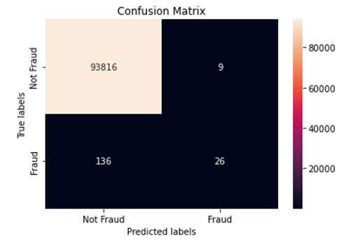
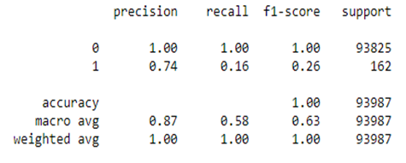
08
Gradient Boosting
As we can see, the F-1 score is really low. It nearly appears that it is not forecasting any fraudulent transactions at all. Let's just use RandomForest for now.

Slide 11
Undersampling
Oversampling
09
Let's move on to dealing with unbalanced data. Oversampling and undersampling are the two most used methods for dealing with unbalanced data.

Slide 12
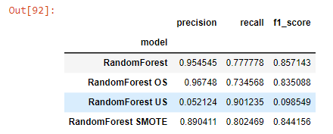
10
Model Comparison
Finally, let's put everything together to compare the different statistics of the four RFM that we built.

Slide 13
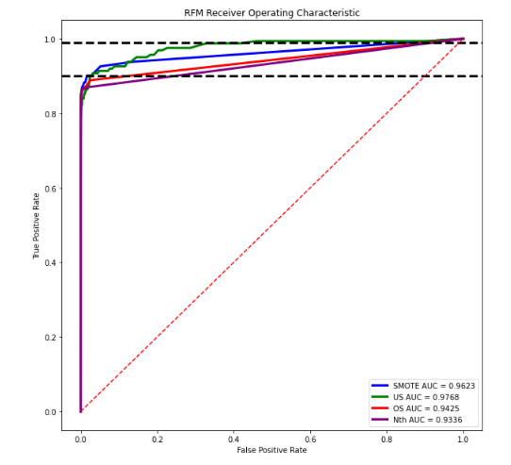
11
Final Graph
Finally, let's take a look at another evaluation metric ROC and AUC, and see if we can extract some insights.

Slide 14
Thanks

